Slide 1
Multi-Modal SLAM Proxy: Fusing 2D LiDAR and Depth Camera for Robust Mapping
Sensor Fusion for Autonomous Robot Navigation
ROS 2 Humble · RTAB-Map · LiDAR + RGB-D + IMU
Karthik Prabu Natarajan (1564587) · Snehamol Sunny (1568233)
Invigilator: Prof. Dr. Peter Nauth

Slide 2
OVERVIEW
Project Overview
🎯 Objective
⚙️ Platform
Build and evaluate a multi-modal sensor fusion SLAM architecture in a simulated warehouse environment using ROS 2 and Gazebo.
BCR Bot — open-source differential drive robot using 2D LiDAR, RGB-D camera, and IMU sensors.
🔗 Approach
🧪 Evaluation
Fuse complementary sensing technologies via EKF + RTAB-Map to improve robustness of simultaneous localization and mapping.
Compare multi-modal vs single-sensor configurations across map quality, trajectory stability, loop closure, and CPU efficiency.

Slide 3
SYSTEM DESIGN
System Architecture
2D LiDAR
RGB-D Camera
IMU
Wheel Odom
/scan
/depth/image_raw
/rgb/image_raw
/imu
/odom
EKF Odometry Fusion
RTAB-Map (Graph-Based SLAM)
Visual odometry · Loop closure · Pose graph optimization
Occupancy Map
/map
Pose Estimate
/localization_pose
Loop Closures
/rtabmap/loop_closure

Slide 4
METHODOLOGY
Sensor Suite & EKF Fusion
📡
📷
🔩
2D LiDAR
RGB-D Camera
IMU + Wheel Odom
/scan
/depth + /rgb
/imu + /odom
✦ 10 Hz planar scans
✦ Dense depth + color
✦ High-freq stabilization
Primary role
Loop Closure
Primary role
Visual Odometry
Primary role
EKF Motion Prior
Key strength
Works in darkness
Key strength
Feature-rich motion
Key strength
Short-term stability
Output
Geometric constraints
Output
Frame-to-frame pose
Output
/odometry/filtered
Captures surrounding geometry via laser ranging. Forms the backbone for scan matching and structural consistency checks.
Generates synchronized color and depth images for visual odometry and environmental representation.
Fused via Extended Kalman Filter to produce a smoothed motion prior, reducing drift during rotational maneuvers.
IMU + Wheel Odometry → EKF (robot_localisation) → /odometry/filtered → RTAB-Map motion prior

Slide 5
METHODOLOGY
RTAB-Map Localization Framework
Dual-Path Data Flow
Why RTAB-Map?
VISUAL PATH (RGB-D Camera)
Natively supports heterogeneous sensor fusion combining LiDAR and RGB-D within a single unified graph-SLAM framework. Chosen for its ability to evaluate the multi-modal fusion goal of this project.
→ Extract visual features (edges, textures)
→ Frame-to-frame pose estimation
→ Dense local map representation
GEOMETRIC PATH (2D LiDAR)
→ ICP scan matching for global consistency
→ Loop closure detection & triggers
→ Pose graph update on revisit
Both paths converge in Graph-SLAM optimization

Slide 6
IMPLEMENTATION
Implementation Details
A Simulation Setup
· ROS 2 Humble + Gazebo simulation engine
C Transform Tree (TF2)
· Warehouse world loaded via URDF robot descriptions
map
· Gaussian noise injected into all simulated sensors
└─ odom
B Nav2 Stack Integration
└─ base_link
└─ laser_frame / camera_link
· RTAB-Map projects dense 3D cloud to 2D /map occupancy grid
· Nav2 global + local cost maps consume the occupancy grid
· Local map uses rolling window with synchronized sensor streams
· MapsToPose action goals confirmed SLAM output usability

Slide 7
EXPERIMENTS
Experimental Setup
Sensor Fusion
LiDAR Only
Camera Only
LiDAR + RGB-D + IMU
2D LiDAR
RGB-D Camera
Simulation
Bot Sensors
ROS 2 Humble + Gazebo small warehouse world. Repeatable controlled runs without physical hardware constraints.
2D LiDAR (σ = 0.01 m Gaussian noise), RGB-D camera depth + color, and IMU at high frequency.
Physics Modelling
Blackout Simulation
Wheel friction (μ₁, μ₂), inertia tensors, and URDF-defined constraints to closely mimic real-world slippage.
Gazebo directional sun model disabled mid-run. reduces RGB-D feature extraction to zero organically without killing the ROS node.
All sensors use Gaussian noise models to prevent over-fitting to perfect simulation data.

Slide 8
RESULTS
Sensor Configuration Comparison
Camera Only
LiDAR Only
Multi-Modal Sensor Fusion
▸ Near-total mapping failure in darkness
▸ Full boundary traced; no tracking loss
▸ Clean occupancy map + stable path
▸ Visual odometry lost without light
▸ Loop closure achieved repeatedly
▸ Visual + geometric complementarity
▸ No loop closure without features
▸ Dense false-positive closure mesh
▸ Survived sensor blackout seamlessly
▸ High CPU efficiency but unusable
▸ ICP graph saturation → unstable
▸ ICP switched in when RGB-D failed

Slide 9
KEY FINDING
Dynamic Sensor Blackout Test
Blackout Timeline
Midway through navigation, the Gazebo environment lighting was completely disabled sinking the warehouse into darkness and reducing RGB-D visual feature extraction to zero.
The RTAB-Map hybrid strategy seamlessly shifted localization weight to ICP scan-matching from the active 2D LiDAR.
The system supported spatial localization without any coordinate jumps, odometry drift, or map fragmentation.
t = 0
Navigation Start
Full multi-modal fusion active — LiDAR + RGB-D + IMU
Lights Out
Gazebo lighting disabled. RGB-D feature extraction drops to zero.
t = end
Stable Finish
ICP takes over seamlessly. Map integrity preserved.

Slide 10
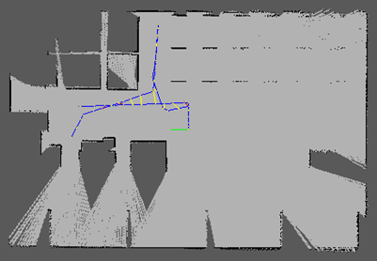
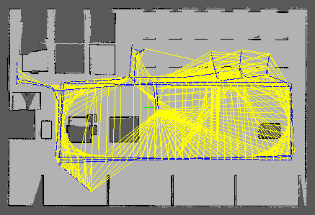
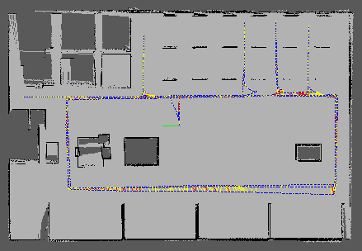
RESULTS
SLAM Graph Comparison
Camera-Only Performance
Lidar-Only Performance
Sensor- Fusion Performance

Slide 11
RESULTS
Quantitative Metric Results
TABLE I — Absolute Trajectory Error (ATE)
Sensor Configuration
Mean ATE (m)
RMSE ATE (m)
Max ATE (m)
Std Dev (m)
Multi-Modal Fusion (LiDAR + RGB-D + IMU)
0.031
0.034
0.082
0.012
LiDAR-Only
0.097
0.103
0.251
0.031
Camera-Only
0.289
0.341
1.820
0.178
TABLE II — Relative Pose Error (RPE, Δ = 1 s)
Sensor Configuration
Mean RPE (m/s)
RMSE RPE (m/s)
Max RPE (m/s)
Std Dev (m/s)
Multi-Modal Fusion (LiDAR + RGB-D + IMU)
0.018
0.027
0.041
0.009
LiDAR-Only
0.044
0.051
0.138
0.024
Camera-Only
0.173
0.219
0.812
0.142

Slide 12
RESULTS
TABLE III — Time-Segmented Blackout Breakdown (Multi-Modal Fusion)
Phase
Active Modality
Mean ATE (m)
Mean RPE (m/s)
Pre-Blackout (0–45 s)
LiDAR + RGB-D
0.024
0.014
Blackout Transition
ICP fallback
0.038
0.047
During Blackout (45–110 s)
LiDAR (ICP)
0.039
0.022
Overall Degradation
—
Δ +0.015 m
Δ +0.008 m/s

Slide 13
CHALLENGES
Key Challenges Encountered
1
Timestamp Synchronization
2
LiDAR-Only Loop Closure Saturation
3
RTAB-Map Database Corruption
4
Computational Load (ICP Density)

Slide 14
CONCLUSION
Key Takeaways
01
Fusion Wins
02
Complementary Strengths
Multi-modal (LiDAR + RGB-D + IMU) achieved the highest overall viability score of 22, outperforming all single-sensor baselines.
LiDAR provides stable geometric constraints under poor lighting; RGB-D delivers dense motion estimation covering each other's weaknesses.
03
Graceful Degradation
04
LiDAR-Only Limitations
The Proxy Architecture survived a complete visual blackout by autonomously shifting to ICP, no map fragmentation or trajectory jumps.
Geometry only SLAM over-saturates the Graph-SLAM optimizer with false-positive loop closures in repetitive warehouse environments.

Slide 15
SOURCE CODE
GitHub link Hosting the Project source code, Report, presentations and demo video is
https://github.com/karthikprabu810/sensor-fusion
Thank you!

